Slide 1
Rightslink for Scientific Communications Touch-Free Workflow
July 1, 2020
Notes:
This PowerPoint Template includes a series of slide masters with predefined layouts and color schemes for formatting slides
Slide Masters are displayed when you right click on a slide and select Layout from menu

Slide 2
Overview of Author Touchfree Workflow
Step 1: Article is accepted for publication
Step 2: The institution is notified
Step 3: The article appears in the funding dashboard
Step 4: Decision is sent to author:
If approved the author is informed the article will be published (Open Access) and charged covered.
If denied (Hybrid), the author is informed their article will be published
If denied (Pure OA), the author is informed and given the option to pay the APC. [Pure OA articles are only in Rightslink if the library has opted to be set up for central payment].

Slide 3
Step 1: Article is accepted for publication
An author has an article accepted for publication.
If metadata matches an existing agreement the author is not contacted.
Metadata is based on title data and agreement information sent to the Rightslink by the publisher and the corresponding author’s Ringgold ID or email domain.
The agreement determines which journals are eligible (eg. Complete Journal Package).

Slide 4
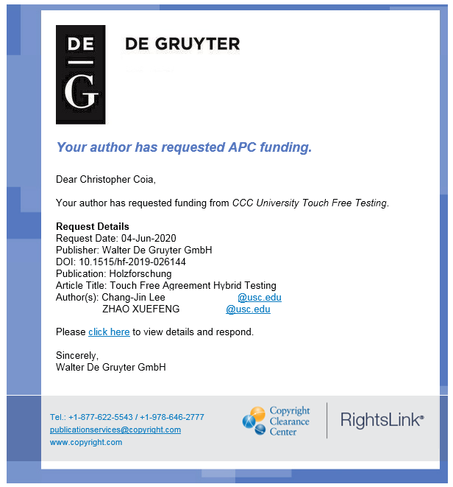
Step 2: The institution is notified
Stockholm University
Research on wood pulp (example title)

Slide 5
Step 3: The article appears in the funding dashboard
Stockholm University
Next, the article appears in your funding dashboard, just as with an article that was not touch-free.
All De Gruyter licenses are CCBY
You can choose to set your De Gruyter agreements to Automatic Approval, in which case you need to take no action. The article will automatically be approved and published Open Access.
Otherwise, you can opt to approve or deny the article. The author will be informed of your choice.

Slide 6
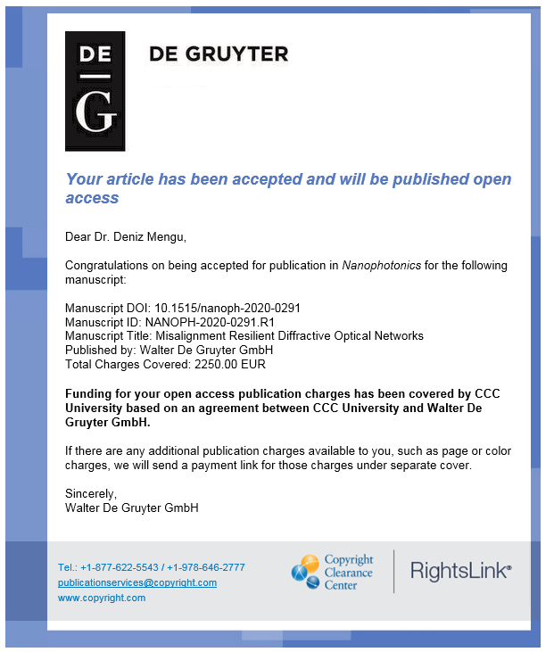
Step 4: The author is notified (approval)
If you approve the article, the author will receive an approval email
Stockholm
Stockholm University and De

Slide 7
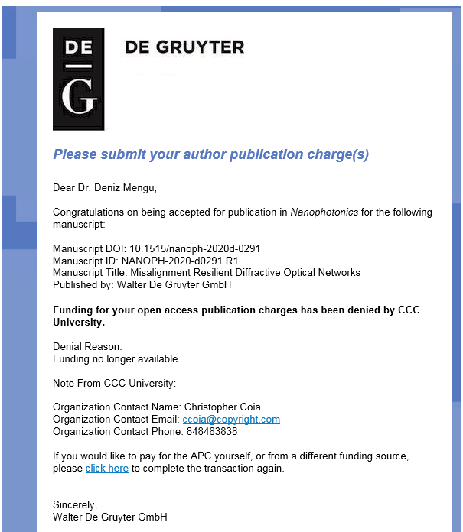
Step 4: The author is notified (denial)
If you deny the article, the author will receive a denial email that includes your denial reason
Stockholm University
Stockholm University

Slide 8
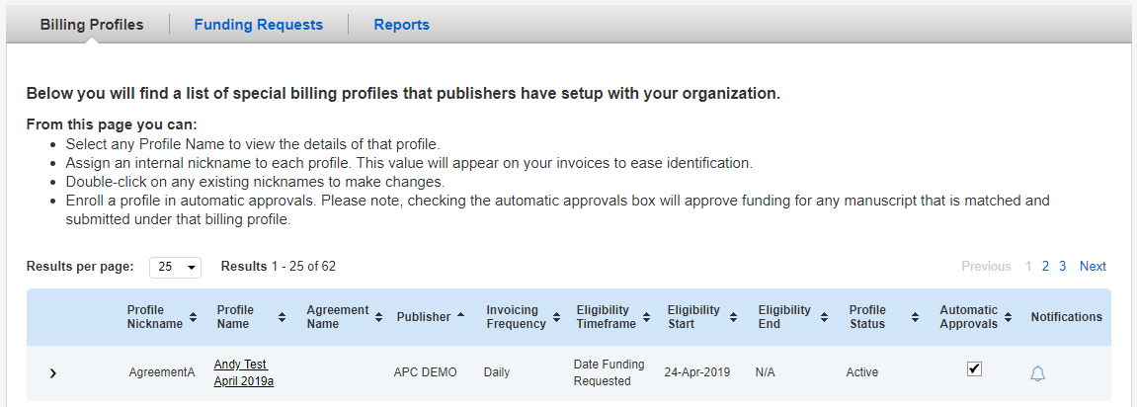
Automatic Approvals
If you wish, you can turn on automatic approvals by clicking the “Billing Profiles” tab in the Instititional Portal, then clicking the
“Automatic Approvals” tick box for each billing profile. When this box is ticked, any funding requests will be approved immediately.

